Slide 1
PROJECT BASED LEARNING
DATA ANALYTICS

Slide 2
PROJECT GOALS
To classify color samples into skin and non skin colors.

Slide 3
DATA SET
Data set contains color samples of skin and non-skin objects.
The data set is collected by randomly sampling B(blue),G(green) and R(red) values from face images of various age groups(young , middle and aged) , race groups(white , black ,Asian) and genders obtained from FERET database and PAL database.
The data set contains a total of 2,45,057 entries.

Slide 4
ATTRIBUTES
First column : color value for blue.
Second column : color value for green.
Third column : color value for red.
Fourth column : Boolean value for skin or non-skin sample in training set.

Slide 5
DATA SET SAMPLE
74 85 123 1
73 84 122 1
72 83 121 1
70 81 119 1
199 197 163 2
199 197 163 2

Slide 6
DESCRIPTION ABOUT THE SRS
External Interface Requirements:
a) User Interfaces : The software provides a simple interface where users will be able to specify location of the color file. The predicted class will be displayed at the bottom.
b) Hardware Interfaces: Cluster of machines if the user wants to take advantage of parallel processing otherwise none.
c) Software Interfaces : The software communicates with Apache Hadoop. It uses HDFS for storing files and mapreduce framework for parallel processing.
d) Communication Interfaces: The software communicates internally with the main network module and other modules

Slide 7
Functional Requirements
Cleaning the Data: The input data will be checked to eliminate rows with empty or bad color values.
Test/Train Split: The software splits the input data randomly into training and testing data.
Normalize the data: The software normalizes the training the data to have mean 0 and SD of 1
Train the model: The software trains the neural network model using the training data.
Apply the model: The trained model is applied to the test data and results are obtained.

Slide 8
Software System Attributes
Reliability: We have included different race’s skin samples like Asian etc for training the model. So, the system is highly accurate in predicting the result.
Availability: The software will be available at all times.
Security: There are no security issues with this system as there is no confidential input and does not access files in hdfs apart from the ones it requires for training and testing.
Portability: The software can be used on any operating system as there no OS specific code as long as that OS is supported by Hadoop.
Maintainability: The Code is modularized and can be modified easily. It is written in such a way that new features can be implemented easily.
Performance: Performance of the software depends on the extent of parallel processing involved and power of systems involved for parallel processing. The algorithms are optimized to provide the best performance.

Slide 9
Performance Requirements
The user can run the software either in a cluster to exploit parallel processing or in a single machine. Running in cluster will have performance benefits like lesser computation time etc compared to running in single machine. Machines with adequate processor speed and memory are needed for fast computations
There is no requirement for a database for the operation of this software.
Database Requirement

Slide 10
Design Constraints
The major constraint is OS. Since Hadoop only works in some OS, the software is limited to such OS. Sufficient space is needed in the Hadoop File System for the storage of training data.There no other requirements .

Slide 11
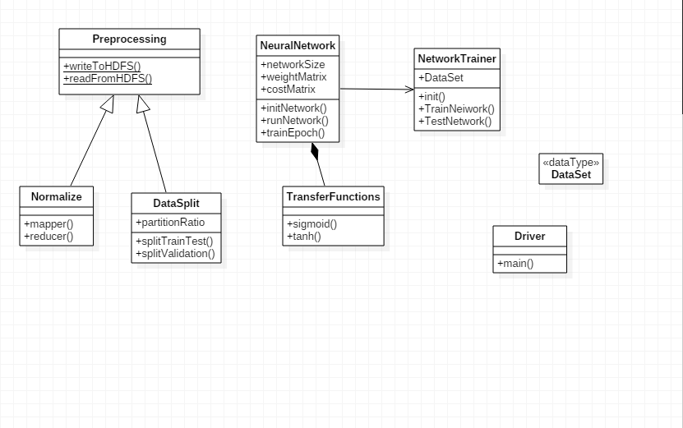
DESIGN ARCHITECTURE Class Diagram

Slide 12
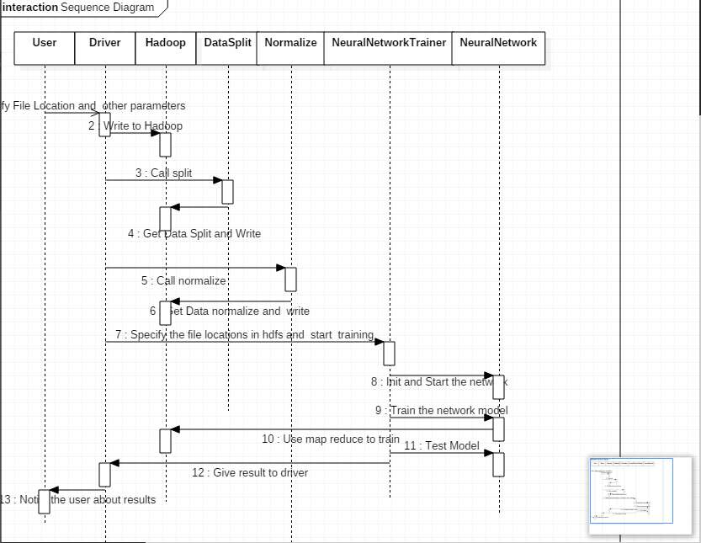
Sequence Diagram

Slide 13
IMPLEMENTATION DETAILS
Neural net package is used to train the data set.
Neural network of three input neurons,10 hidden neurons and one output neuron is established.
The raw data set is normalized using the function as shown below (x - min(x))/(max(x) - min(x))
The data set is partitioned using CARET (classification and regression training) package.

Slide 14
IMPLEMENTATION DETAILS
75% of the data set is partitioned into training data.
25% of the data set is considered to be tested data.
The training data is used to train neural network.
Testing data is fed to the neural network.Many iterations are performed to obtain the result inline with training data outcomes.
Regression analysis is performed and the graph is plotted.

Slide 15
RESULT
Color samples are classified into skin and non skin colors samples.

Slide 16
CONCLUSION
Skin color detection is generally a pre-processing step in many application such as face detection and gesture tracking, and algorithms have been proposed for this task. Nevertheless, skin detection is still a challenging task as the proposed techniques could not overcome the overcome the problems of illumination and background which produces high FPRs. In order enhance the detection accuracy, ANNs have been adopted for skin detection performance. However, a fair benchmark is still required to explore their advantage and disadvantages. Computation time and complexity are very important aspects in any real-time application in which skin detection may be involved, but all reviewed papers not discussed these aspects. Moreover , the optimum color space for ANN-based skin detection is still unrevealed. More serious trials are expected to come up with more sophisticated ANN-based techniques which fit into real-time application requirement in terms of accuracy and speed of computation as well.

Slide 17
Bibliography
HANI K. AL-MOHAIR, JUNITA MOHAMAD-SALEH AND SHAHREL AZMIN SUANDI, HUMAN SKIN COLOR DETECTION:A REVIEW ON NEURAL NETWORK PERSPECTIVE.
J Han, G Awad and A Sut herland, Automatic skin segmentation and tracking in sign language recognition.
J S Lee, Y M Kuo and P C Chung, Detecting nakedness in color images, Intelligent Multimedia Analysis for security Applications.
M Rasheed, face detection based on skin color point pixel processing using OpenCV, http://aspilham blogspot.com/2011/01/face-detection-based-on-skin-color.html
https://archive.ics.uci.edu/ml/datasets/Skin+Segmentation

Slide 18
THANK YOU

